Slide 1
Schakende computers stimuleren AI-onderzoek
ICCF Congress 2023
Amsterdam, August 21
Double Tree by Hilton
Amsterdam Centraal Station
Oosterdokstraat 4
Amsterdam, The Netherlands
Chess – Science - Communication

Slide 2
ICCF Congress 2023
Amsterdam, August 21

Slide 3
Program ICCF Congress 2023
August 21, 20:00 – 23:00 Chess – Science - Communication
20:00 Welcome by the organisation
NBC – Henk van den Bos CSVN – Ruud Martin MEC – Paul van der Sterren 20:15 Moderator – Jaap van den Herik

Slide 4
Full Evening Program
20:00 Welcome by the organisation 20:15 Prof. Dr. Jaap van den Herik
Computers: From Beginners to Over Champions
20:45 Chief Arbiter Richard Pijl
Playing Strength at the WCCC 2023 in Spain
21:05 Break
21:15 Dr. Dap Hartmann
Hans Berliner's Life, hobby and profession
21:45 Break
21:50 ICCF World Champion Jon Edward
The Marshall talk
22:45 Q&A Panel
23:00 End evening program

Slide 5
Computers: From Beginners to Over Champions
Jaap van den Herik
Prevailing Question:
Will our intelligence be replaced by AI?
Thank you:
Hans Böhm for being a long life opponent
Genna Sosonko for your companionship from the beginning Ron de Goeij and Walter Doorduin for your help with this presentation
See also: (1) Computer Chess: From idea to DeepMind (IOS Press / ICGA Journal)
(2) AI and Computer Chess in the Netherlands (KNSB / NBC)

Slide 6
Computers: From Beginners to Over Champions
Question 1: Perfect chess by computer?
Question 2: Perfect thinking by computer?
Is this the future?
Is this OUR future?
Does Chat GPT shift the balance between
human intelligence and AI?

Slide 7
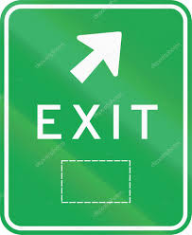
Computers: From Beginners to Over Champions
What precisely did lead us to question 1 and 2?
Hans Böhm believes 1997 (exit Kasparov)
Jaap van den Herik believes 2017 (exit Ke Jie)

Slide 8
Computers: From Beginners to Over Champions
How the world accepted the changes by AI?
1997 – Chess
May 11th 1997: AI achieves its long-standing goal. DEEPBLUE (IBM) wins from Kasparov by 3 ½ - 2 ½
“Deep Thinking” | Kasparov
the link above works

Slide 9
From Mythology to Science Fiction
How the world accepted the changes by AI?
2017 – Go
ALPHAGO has defeated Ke Jie, the world’s number one Go player, in their match, meaning the AI has secured a clear victory.
The win over Ke, universally considered the best Go player in the world, essentially confirms that ALPHAGO has surpassed human Go ability a little over a year after the AI first beat Lee Se-dol.
Source: https://www.theverge.com/2017/5/25/15689462/alphago-ke-jie-game-2-result- google-deepmind-china

Slide 10
From Mythology to Science Fiction
How the world accepted the changes by AI?
30 November 2022 Chat GPT
Open AI launches Chat GPT
GPT means: Generative
Pre-trained Transformation
It is the perfect Handyman:
Games
Industrial revolutions
Art (compositions, paintings, music)
And ... the art of programming

Slide 11
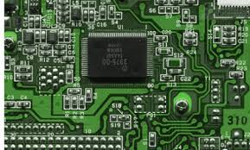
From Mythology to Science Fiction
From idea (1769) to reality (2023)
Imagination
Three breakthroughs
Two founding fathers
AI and the chess world
The main constructors
Playing strength

Slide 12
From Mythology to Science Fiction
Our approach is looking into the future and considers:
The power of imagination
Computers
Artificial Intelligence
Deep Learning
Super Intelligence

Slide 13
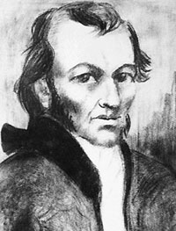
From Mythology to Science Fiction
The power of imagination
1769 Wolfgang von Kempelen
“I will invent a machine for a more compelling spectacle within half a year”

Slide 14
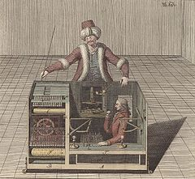
From Mythology to Science Fiction
The power of imagination
1769 Wolfgang von Kempelen 1770 De Turk
“I will invent a machine for a more compelling spectacle within half a year”

Slide 15
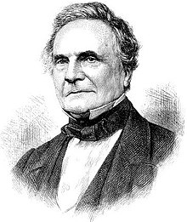
From Mythology to Science Fiction
Three Breakthroughs
Charles Babbage 1791 – 1871
Analytical Engine

Slide 16
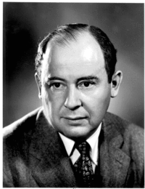
From Mythology to Science Fiction
Three Breakthroughs
Charles Babbage 1791 – 1871
Analytical Engine
John von Neumann 1903 - 1957
Minimax-method

Slide 17
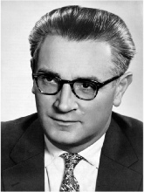
From Mythology to Science Fiction
Three Breakthroughs
Charles Babbage 1791 – 1871
Analytical Engine
John von Neumann 1903 - 1957
Minimax-methode
Konrad Zuse 1910 – 1995
Z3-machine

Slide 18
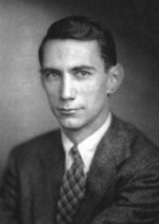
From Mythology to Science Fiction
The first founding father
Claude Shannon 1916 – 2001
Programming a Computer for Playing Chess 1950

Slide 19
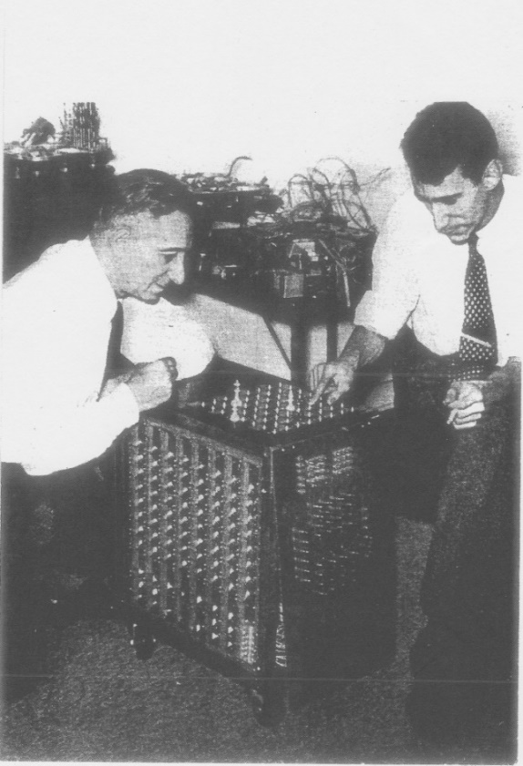
From Mythology to Science Fiction
The first founding father
Claude Shannon 1916 – 2001
Programming a Computer for Playing Chess 1950
Claude Shannon demonstrating his (home-made) electric chess automation to Chessmaster Edward Lasker

Slide 20
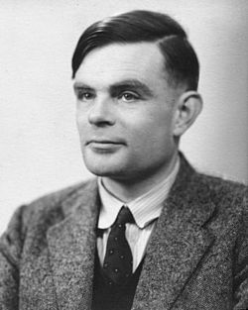
From Mythology to Science Fiction
The second founding father
Alan Turing 1912 – 1954
“Computing Machinery and Intelligence” 1950

Slide 21
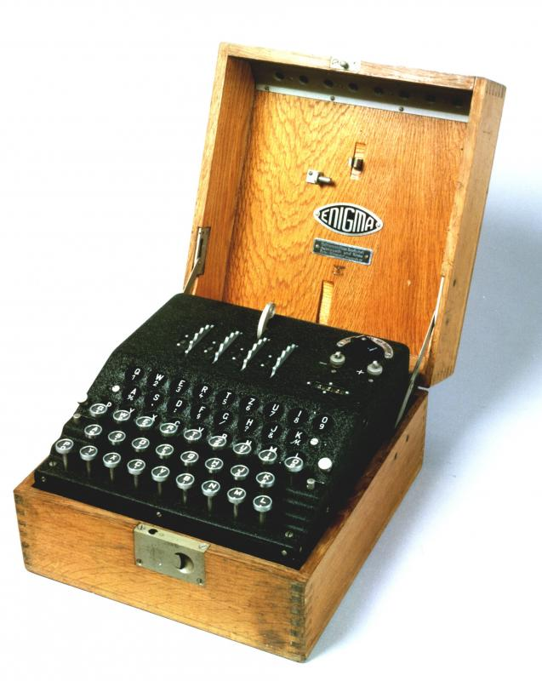
From Mythology to Science Fiction
The second founding father
Alan Turing 1912 – 1954
“Computing Machinery and Intelligence” 1950
Enigma a-320 (WW II)
“Digital Computers applied to Games” 1953

Slide 22
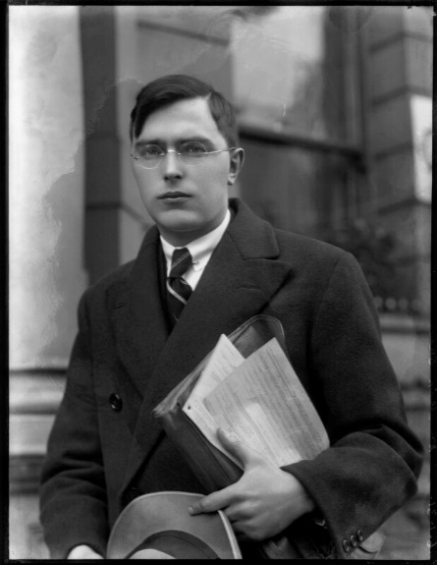
From Mythology to Science Fiction
AI and the chess world
Euwe 1929
Mengentheoretische Betrachtungen über das Schachspiel

Slide 23
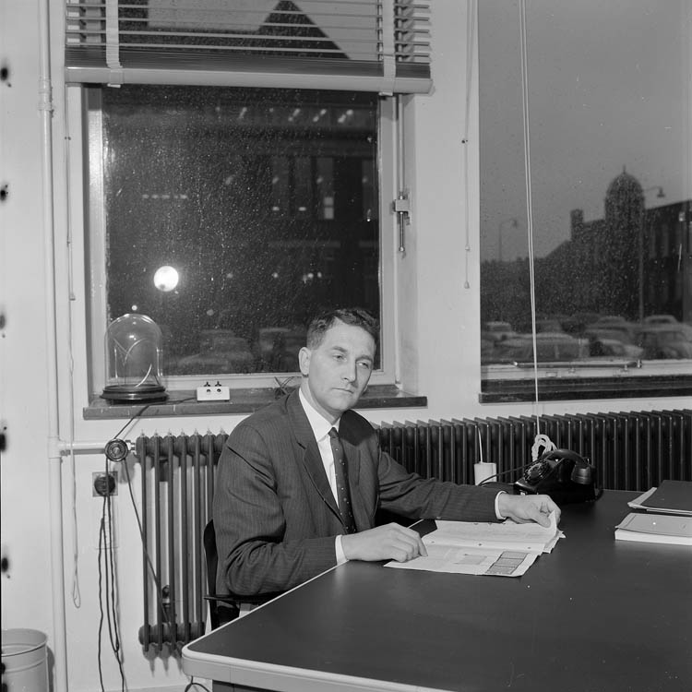
From Mythology to Science Fiction
AI and the chess world
Euwe 1929
Mengentheoretische Betrachtungen über das Schachspiel
Van der Poel 1955
King + Rook versus King algorithm

Slide 24
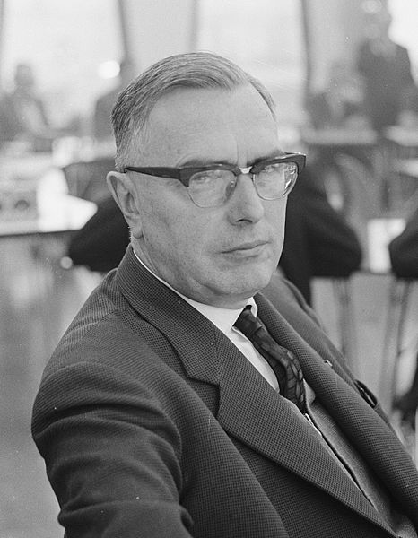
From Mythology to Science Fiction
AI and the chess world
Euwe 1929
Mengentheoretische Betrachtungen über das Schachspiel
Van der Poel 1955
King + Rook versus King algorithm
Euwe 1963
Euratom report Computers and
the Game of Chess

Slide 25
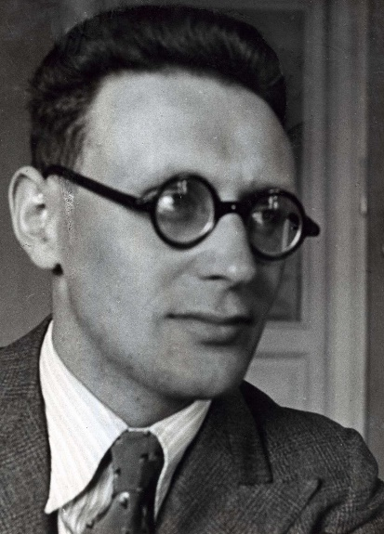
From Mythology to Science Fiction
AI and the chess world
Euwe 1929
Mengentheoretische Betrachtungen über das Schachspiel
Van der Poel 1955
King + Rook versus King algorithm
Euwe 1963
Euratom report Computer and the Game of Chess
Botvinnik 1965
Ideas on Pioner,
a world chess championship program

Slide 26
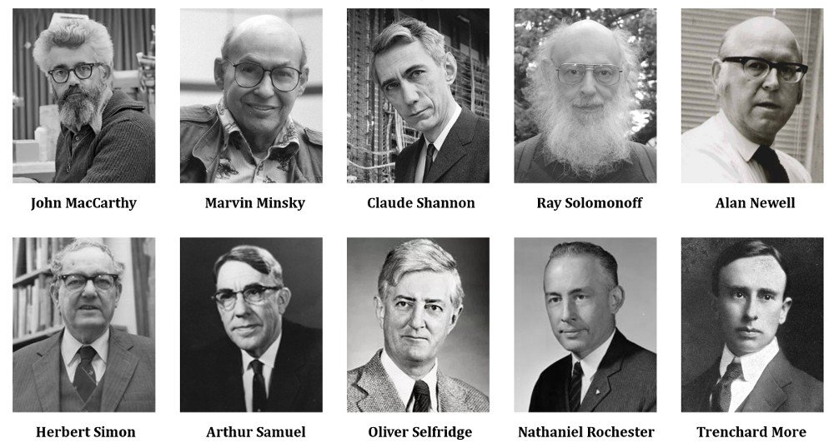
From Mythology to Science Fiction
Dartmouth Conference 1956
The main constructors of AI

Slide 27
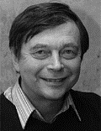
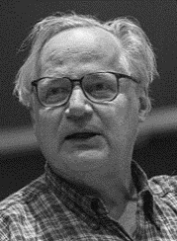
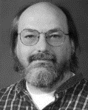
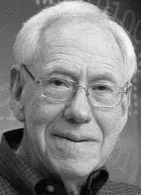
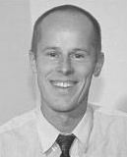
From Mythology to Science Fiction
Playing strength
Mac Hack Six
A Founding Programmer at MIT
Tournament Play (0.5 out of 5)
Rating 1243 (Class D)
1974: Kaissa
1977: Chess
1980: Belle
1983: Cray Blitz
1986: Cray Blitz
1988: Deep Thought
1992: The Chess Machine
1995: Fritz
Note: Only the first program author is pictured
Donskoy
Slate
Richard D. Greenblatt
Thompson
“Alchemy and Artificial Intelligence” 1965
Quoting Simon, he added:
“Still no chess program can play even amateur chess and the world championship is only 2 years away.”
Hyatt
Feng-hsiung Hsu
Hubert Dreyfus
Schröder

Slide 28
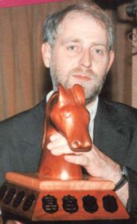
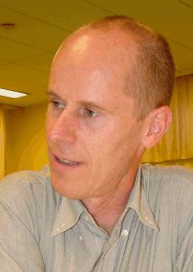
From Mythology to Science Fiction
Dutch world champions
1992 – Ed Schröder
(7th WCCC, Madrid, Spanje)
1995 – Frans Morsch
and Matthias Feist
(8th WCCC, New York, USA)

Slide 29
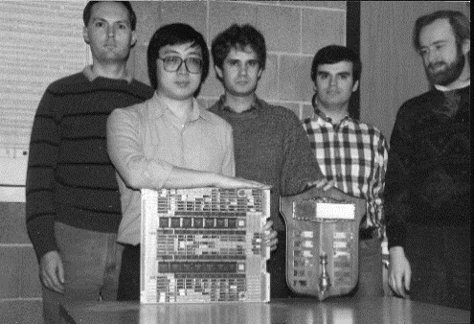
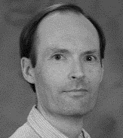
From Mythology to Science Fiction
Most important development (1996)
Carnegie-Mellon University
1985: ChipTest
1988: Deep Thought
1995: Deep Blue
4 ICCA Journal Publications (1988-1997)
Feng-hsiung Hsu
Murray Campbell,
Feng-hsiung Hsu,
Thomas Anantharaman,
Mike Browne and
Andreas Nowatzyk.
Murray Campbell
After winning the Fredkin Intermediate Prize for Deep Thought's Grandmaster-level performance.
Thomas Anantharaman

Slide 30
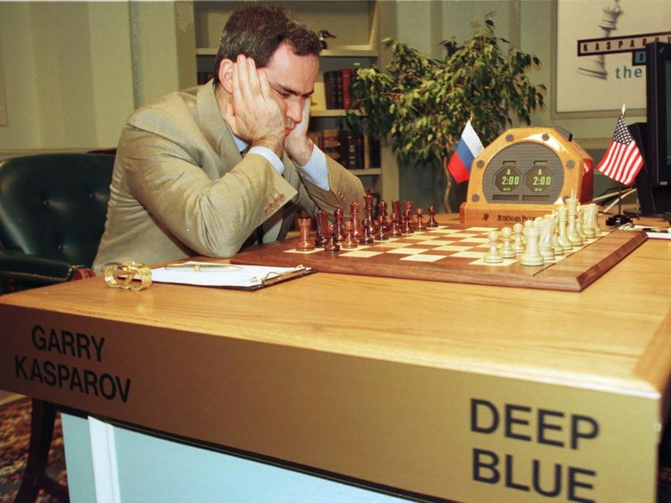
From Mythology to Science Fiction
Most important development (1996)
Carnegie-Mellon University
1985: ChipTest
1988: Deep Thought
1995: Deep Blue
4 ICCA Journal Publications (1988-1997)
1996: First Match Kasparov – Deep Blue: 4 - 2
Feng-hsiung Hsu
Murray Campbell,
Feng-hsiung Hsu,
Thomas Anantharaman,
Mike Browne and
Andreas Nowatzyk.
Murray Campbell
After winning the Fredkin Intermediate Prize for Deep Thought's Grandmaster-level performance.
Thomas Anantharaman

Slide 31
From Mythology to Science Fiction
How the world accepted the changes by AI?
1997 – Chess
May 11th 1997: AI achieves its long-standing goal. DEEPBLUE (IBM) wins from Kasparov by 3 ½ - 2 ½
“Deep Thinking” | Kasparov
Exit Böhm (1997) the link above works

Slide 32
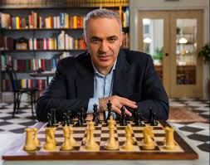
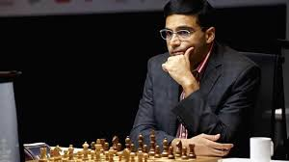
From Mythology to Science Fiction
Computer as a second of Kasparov and Anand

Slide 33
From Mythology to Science Fiction
How the world accepted the changes by AI?
2017 – Go
ALPHAGO has defeated Ke Jie, the world’s number one Go player, in their match, meaning the AI has secured a clear victory.
The win over Ke, universally considered the best Go player in the world, essentially confirms that ALPHAGO has surpassed human Go ability a little over a year after the AI first beat Lee Se-dol.
Source: https://www.theverge.com/2017/5/25/15689462/alphago-ke-jie-game-2-result- google-deepmind-china
Exit van den Herik (2017)

Slide 34
From Mythology to Science Fiction
The step to Deep Learning
(i.e., without human knowledge)
2017 – AlphaGo Zero defeats
computer world champion by 100 - 0

Slide 35
From Mythology to Science Fiction
Deep learning and chess
2017 – AlphaZero defeats Stockfish by 28 – 0 (72 draws). Otherwise stated: 64 - 36

Slide 36
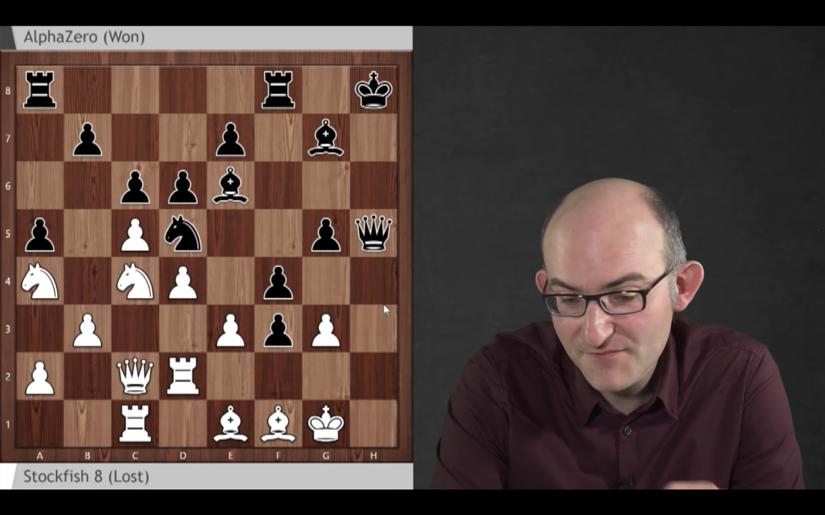
From Mythology to Science Fiction
An example of AlphaZero defeating Stockfish
(by Ken Regan)
Long-term Sacrifice: Stockfish 0-1 AlphaZero:
It wasn’t AlphaZero’s choice to play the Leningrad Dutch, but it made Matthew very jealous! The game features a cascade of sacrifices, with Sadler noting of one of them, “I don’t think I’ve ever seen a tactic like this”.
https://chess24.com/en/read/news/alphazero-really-is-that-good

Slide 37
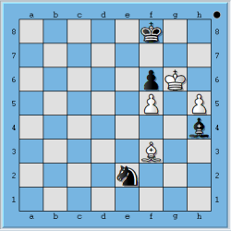
From Mythology to Science Fiction
Carlsen – Caruana – partij 6
commented by Stockfish
(noted down by Ken Regan)
It came from a supercomputer named Sesse running the chess engine Stockfish: Black has checkmate in 36 moves beginning 68…Bg5-h4! At first this looks suicidal since after 69.h5-h6 Black’s king is cut off and his knight and bishop look far from stopping the pawn. But after 69…Nd4-f3 (or 69…Nd4-c6) 70.h6-h7 Nf3-e5+ 71.Kg6-h6 Bg5+, White’s king is evicted and after 72.Kh6-h5 Kf8-g7 73.Bc4-g8 Kg7-h8, the compulsion to move (called Zugzwang) forces White to unguard the pawn since his king is frozen.
So White covers the c6 and f3 squares by 69.Bc4-d5 and after 69…Nd4-e2 both guards his h-pawn and puts a question to Black’s knight by 70.Bd5-f3. Now if you haven’t already heard about this, see if you can not only come up with Black’s winning move but the plan of why it works:
There is however a further wrinkle, which is that computers can help us generate humanly understandable explanations. I believe this is a case in point—not only to explain why Black wins here but also how and why White was safe until voluntarily moving the king from h7 to g6 at turn 67. The first point of 70…Nf3-g1!! is to buy time after 71.Bf3-g4 Kf8-g8! to block White’s h-pawn. Owing to Zugzwang, White must either cede ground or release the trapped knight, both of which are fatal. White can head off Black’s king by 71.Bf3-d5 instead, but 71…Bh4-g5! wrong-foots White: 72.Kg6-h7 Ng1-e2 and a fork will come on g3 or f4; or 72.Bd5-c4 Ng1-h3! 73.Kg6-h7 Nh3-f4 and White’s bishop is boxed out of e2, so White’s h-pawn must come forward to its eventual doom.
https://rjlipton.wordpress.com/2018/11/25/far-from-a-turkey-shoot/

Slide 38
From Mythology to Science Fiction
From Machine Learning to Solution
To: Machine learning (2000 - 2020)
To: Adaptation (2005)
To: Automatic Adaptation (2005 - 2015)
To: Autonomy (2015 - 2020)
To: Deep Learning (2015 - 2020)
To: Explainable AI (2020)
To: Interpretable AI (2022)
To: Solution (prediction vdH 2035)

